Slide 1
Introduction to AI / ML and Deep Learning by using TensorFlow
10.03.2021

Slide 2
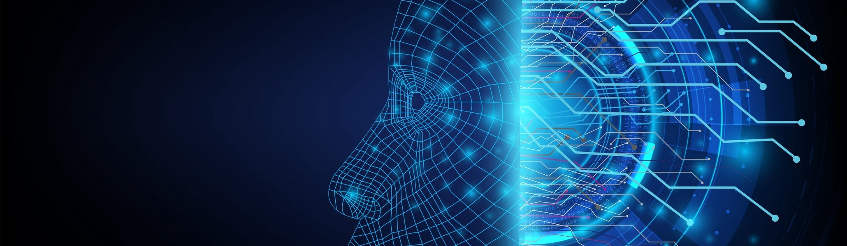
Introduction to AI / ML and Deep Learning by using TensorFlow
10.03.2021

Slide 3

Intro of AI / ML and Deep Learning
Intro of Google Colab
Intro of TensorFlow 2.x
Practical
Convert Celsius Temp into Farhnite Temp
Image Classification with Fashion MNIST Dataset

Slide 4
Agenda
Intro of CNN Convolutional Neural Network
Convolution
Pooling
Practical
Image classification with Fashion MNIST Dataset by using CNN
Image classification with Cat vs Dogs Dataset by using CNN

Slide 5
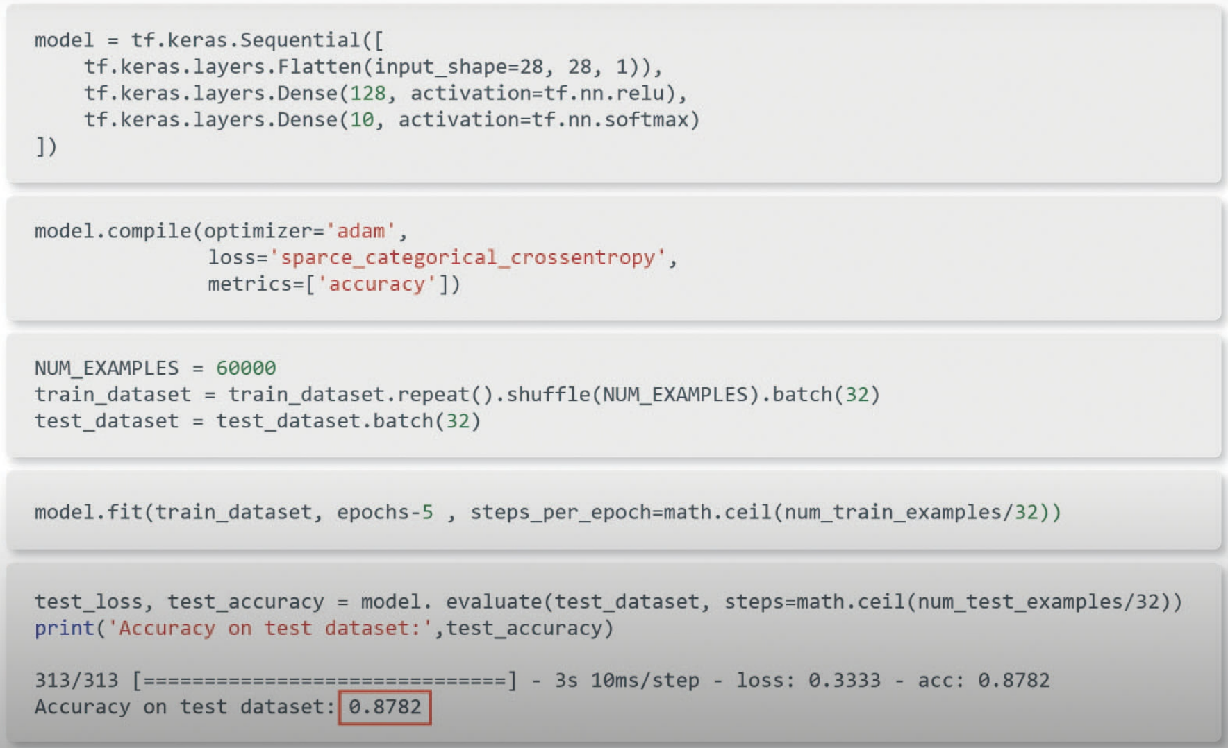
Fashion MNIST Model

Slide 6
CNN – Convolutional Neural Network
Convolution
- A convolution is the process of applying a filter (“Kernel”) to an image.
Pooling
- It is a process of reducing the size of the image through downsampling

Slide 7
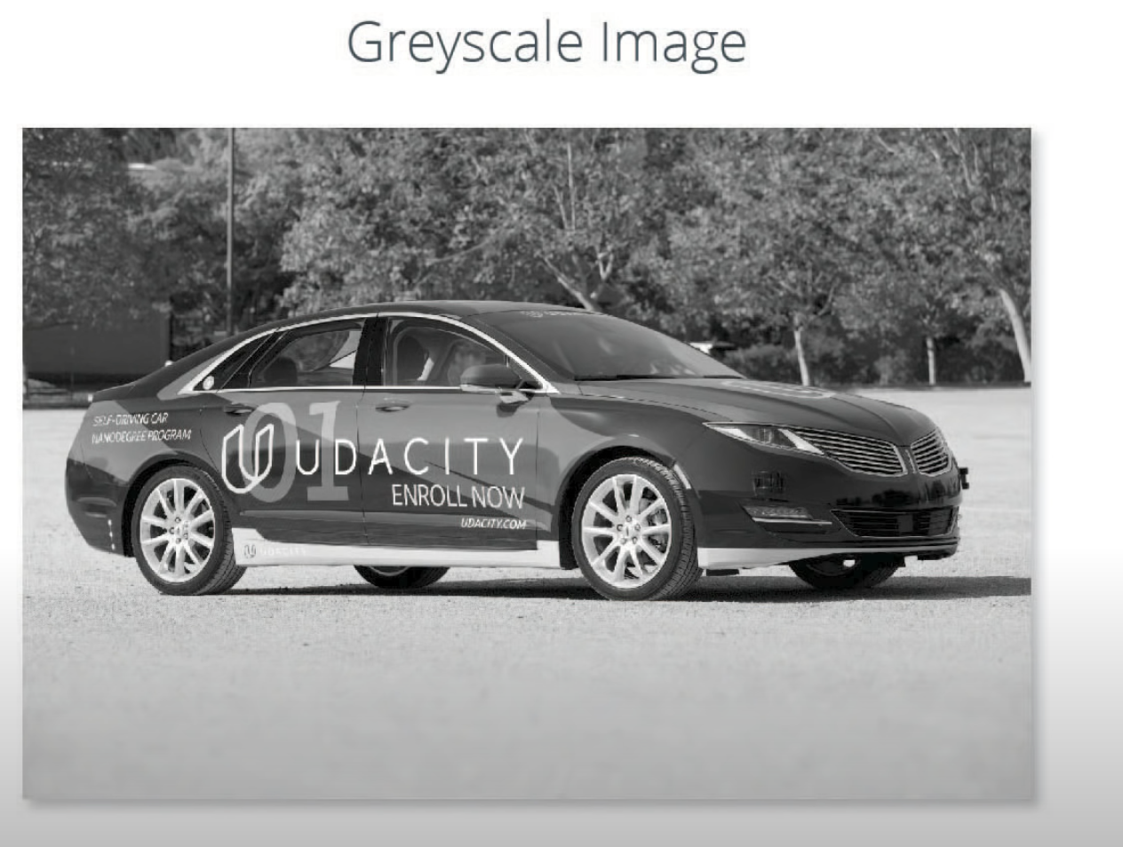
CNN – Convolutional Neural Network
Convolution

Slide 8
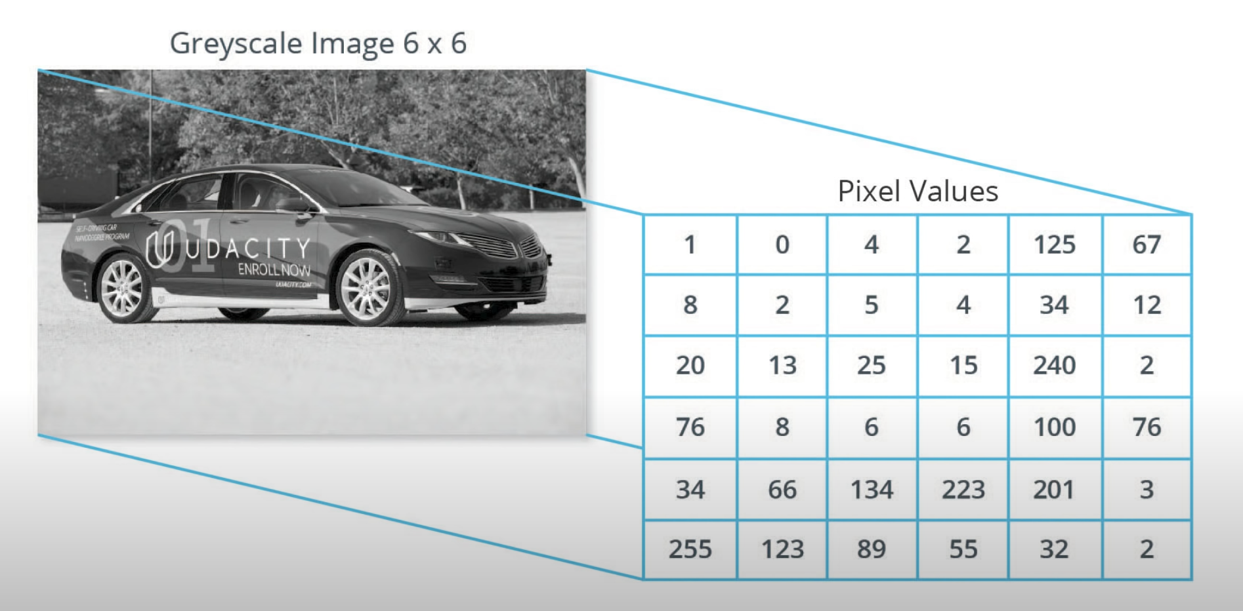
CNN – Convolutional Neural Network
Convolution

Slide 9
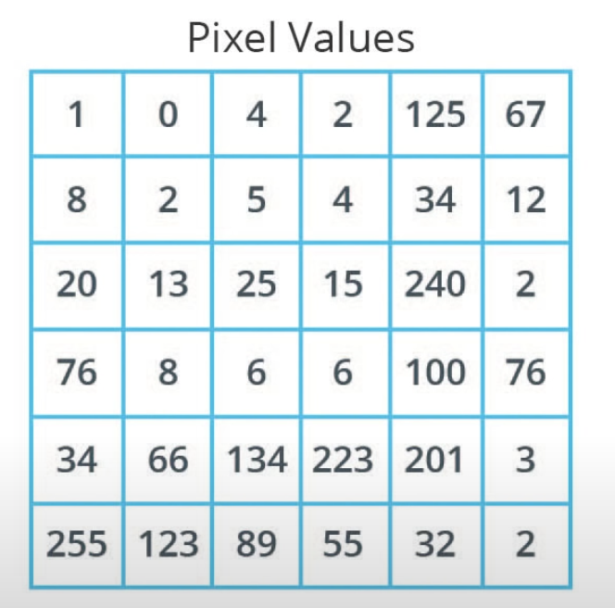
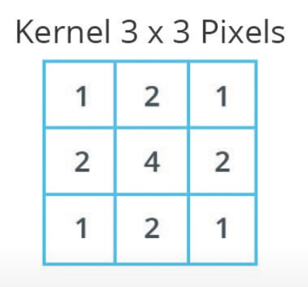
CNN – Convolutional Neural Network
Convolution
Kernel / filter: A matrix which is smaller than the input, used to transform the input into chunks

Slide 10
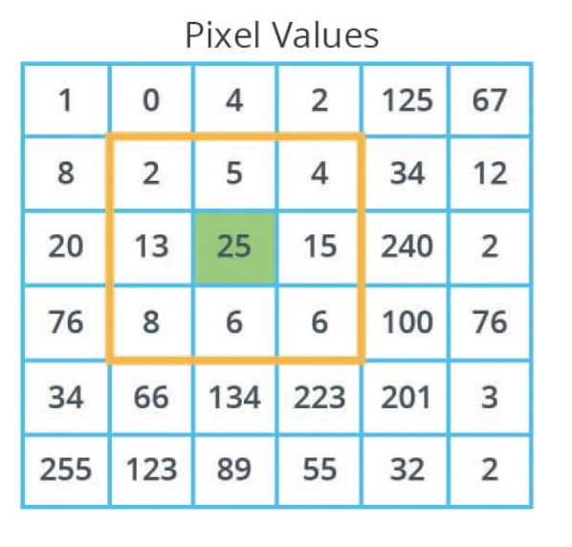
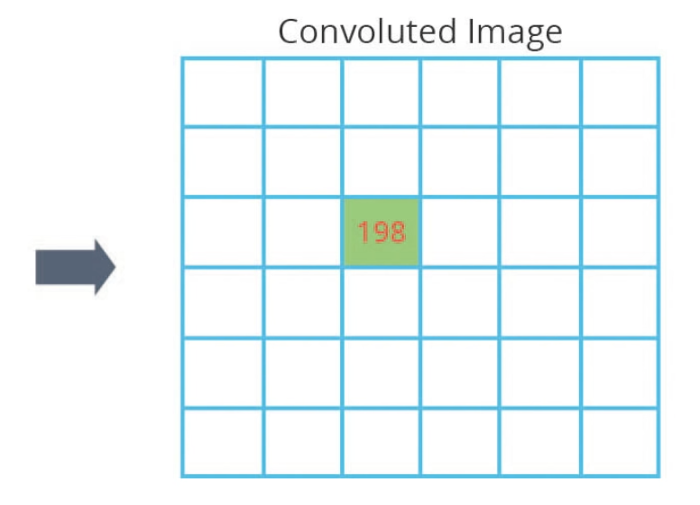
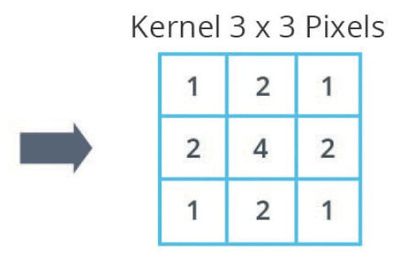
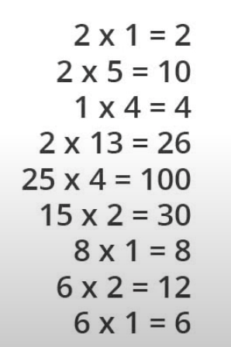

CNN – Convolutional Neural Network
Convolution

Slide 11
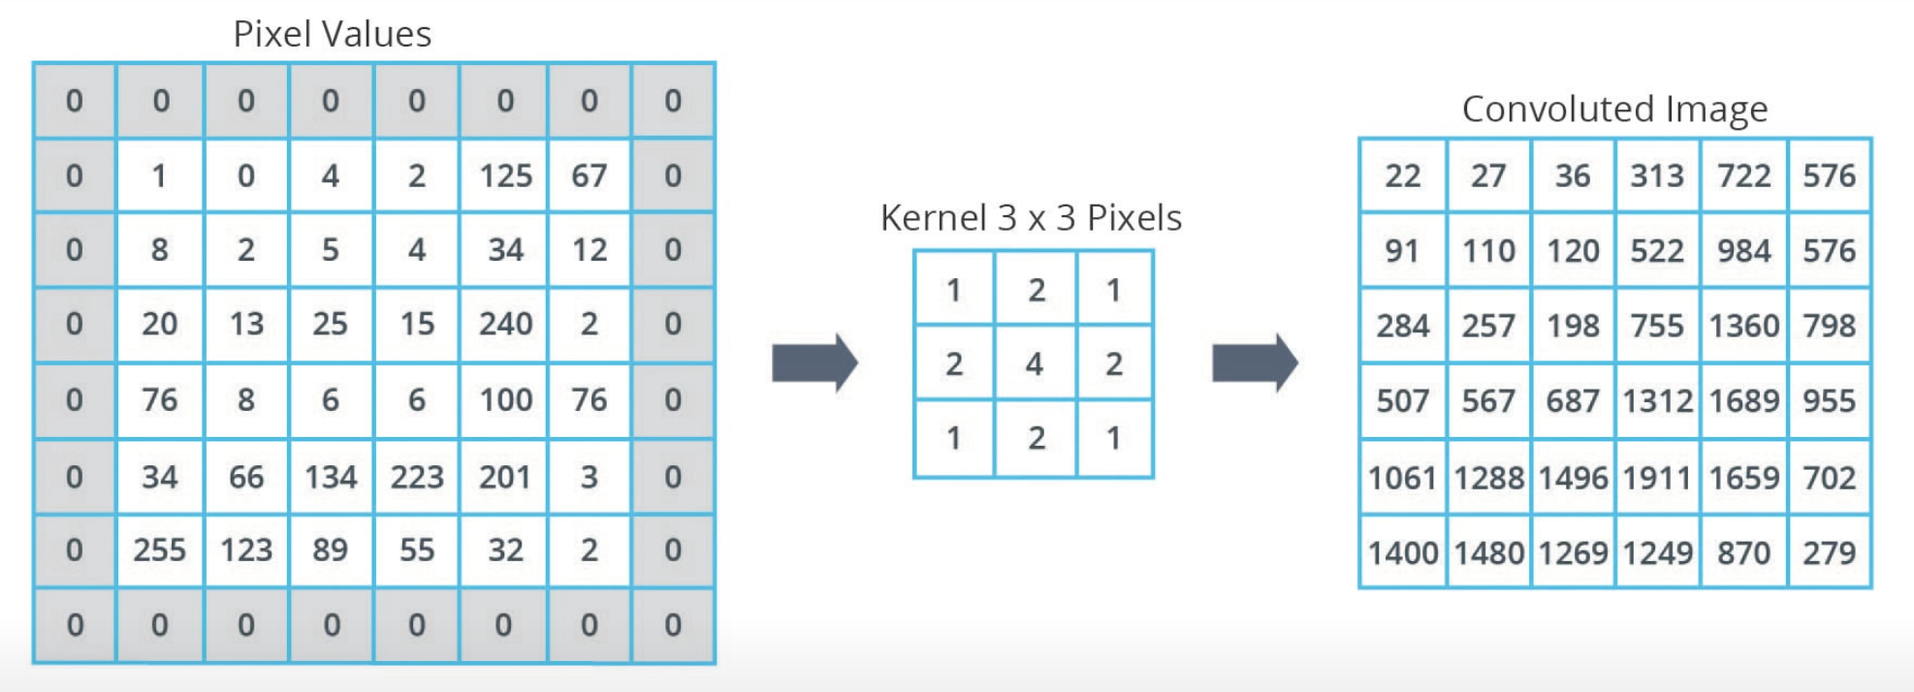
CNN – Convolutional Neural Network
Convolution
Padding: Adding pixels of some value, usually 0, around the input image

Slide 12

CNN – Convolutional Neural Network
Convolution
How to write code for convolutions ?
No. of Filters
Filters Size

Slide 13
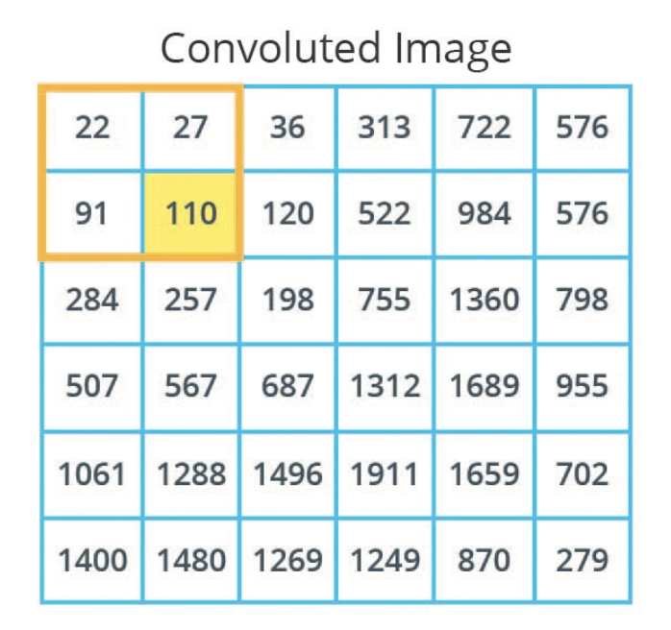
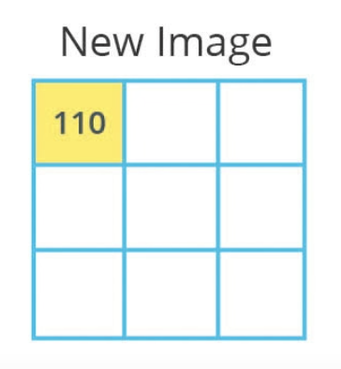
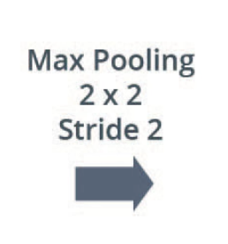
CNN – Convolutional Neural Network
Max Pooling
It is a process of reducing the size of the image through down sampling

Slide 14
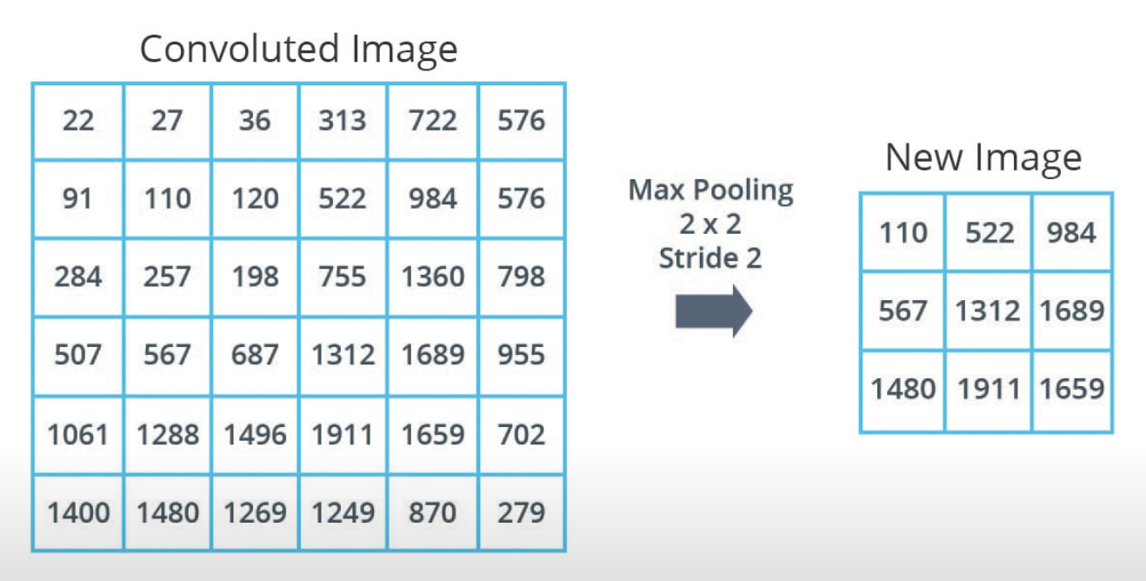
CNN – Convolutional Neural Network
Max Pooling

Slide 15

CNN – Convolutional Neural Network
Max Pooling
How to write code for Max Pooling ?
Pool Size
Stride

Slide 16
Practical

Slide 17
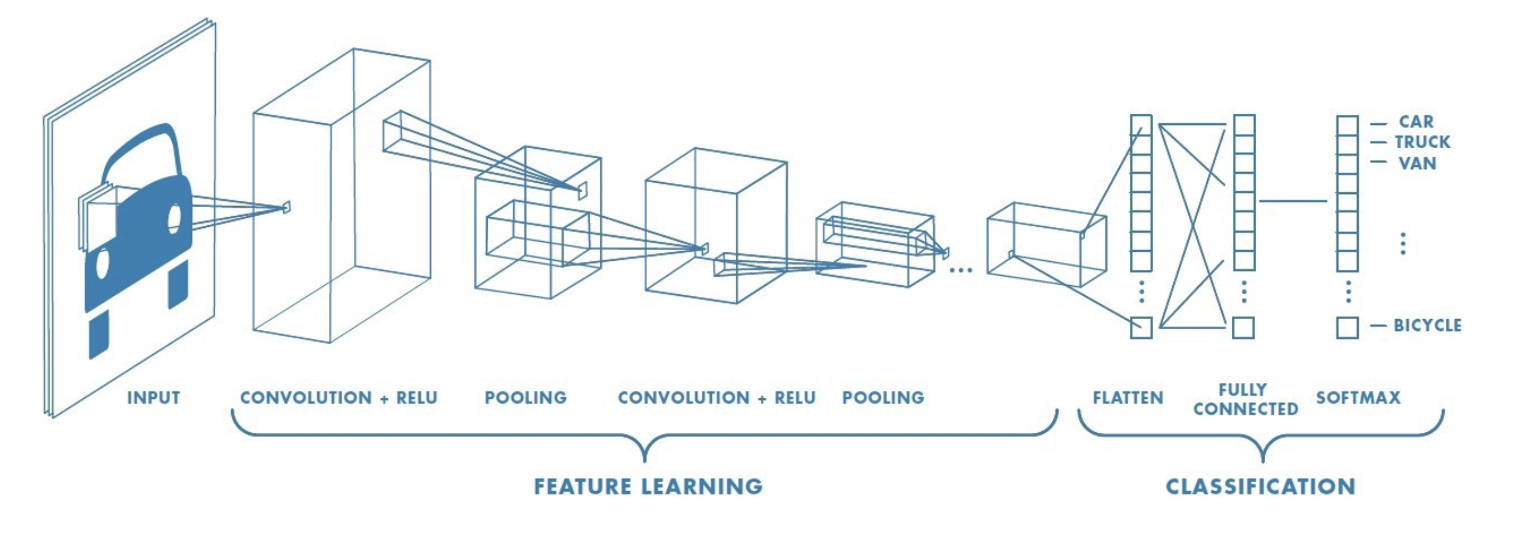

CNN – Convolutional Neural Network
Create Model
https://towardsdatascience.com/a-comprehensive-guide-to-convolutional-neural-networks-the-eli5-way-3bd2b1164a53

Slide 18
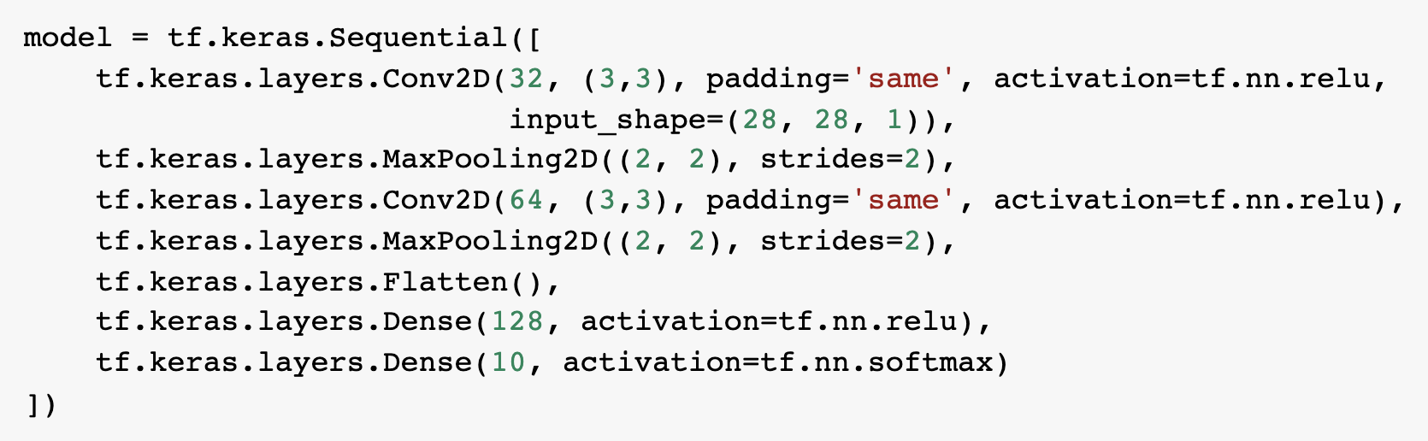
CNN – Convolutional Neural Network
Practical
Create CNN Modal
No of Filters
Size of Filters
https://github.com/DineshChopra/AI-ML/blob/master/TensorFlow/3_CNN_Fashion_MNIST.ipynb

Slide 19

Image Classification with Fashion MNIST dataset by using CNN

Slide 20
Image Classification with Cat vs Dog dataset by using CNN

Slide 21
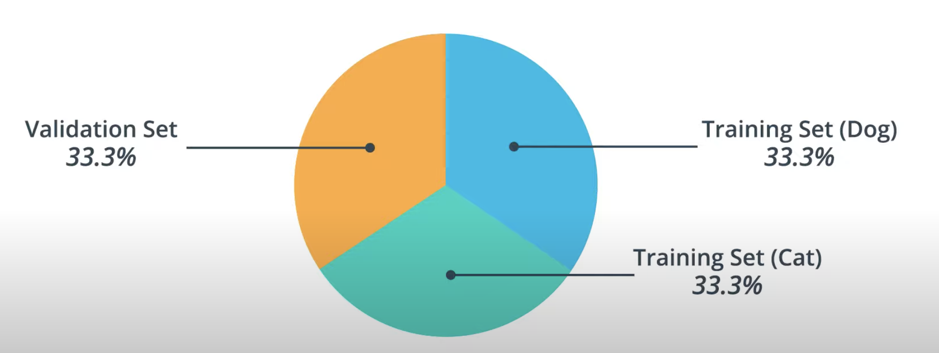
Cats and Dogs Dataset

Slide 22
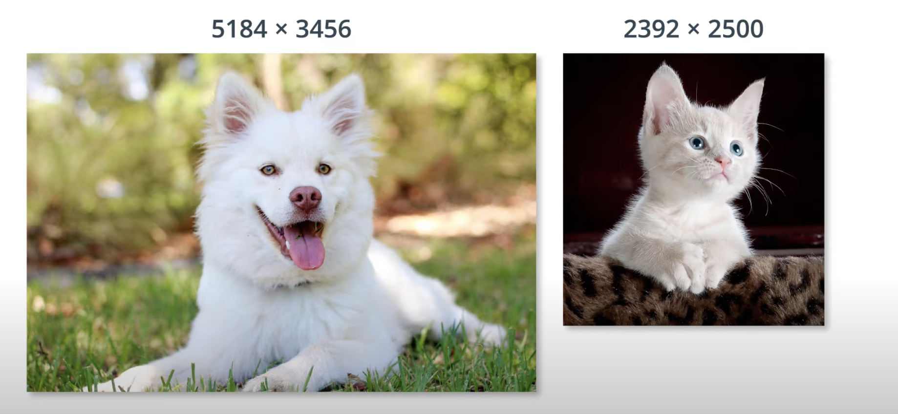
Cats and Dogs Dataset
Cat Label: 0
Dog Label: 1

Slide 23
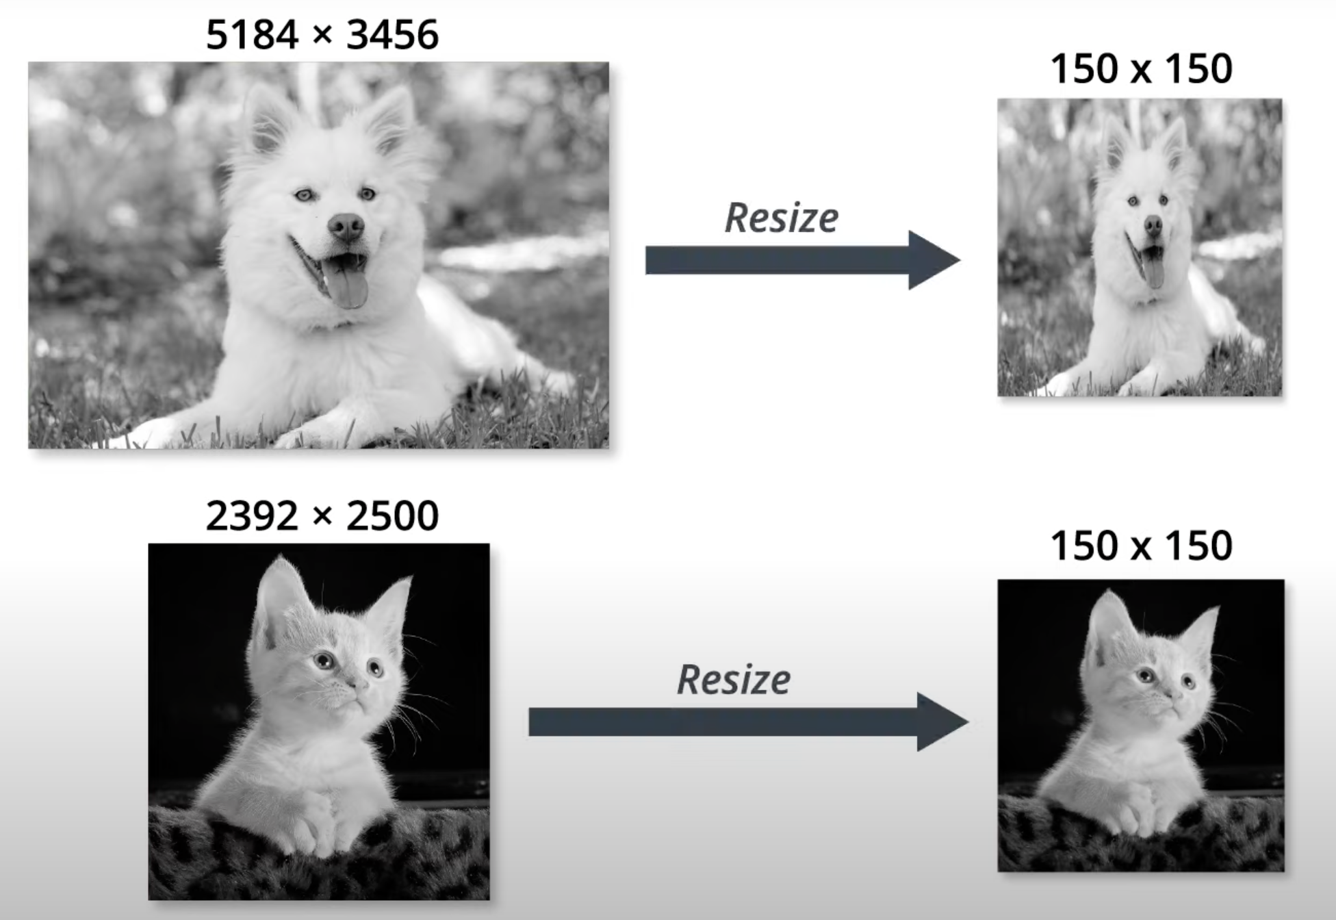
Cats and Dogs Dataset – Resizing Images

Slide 24
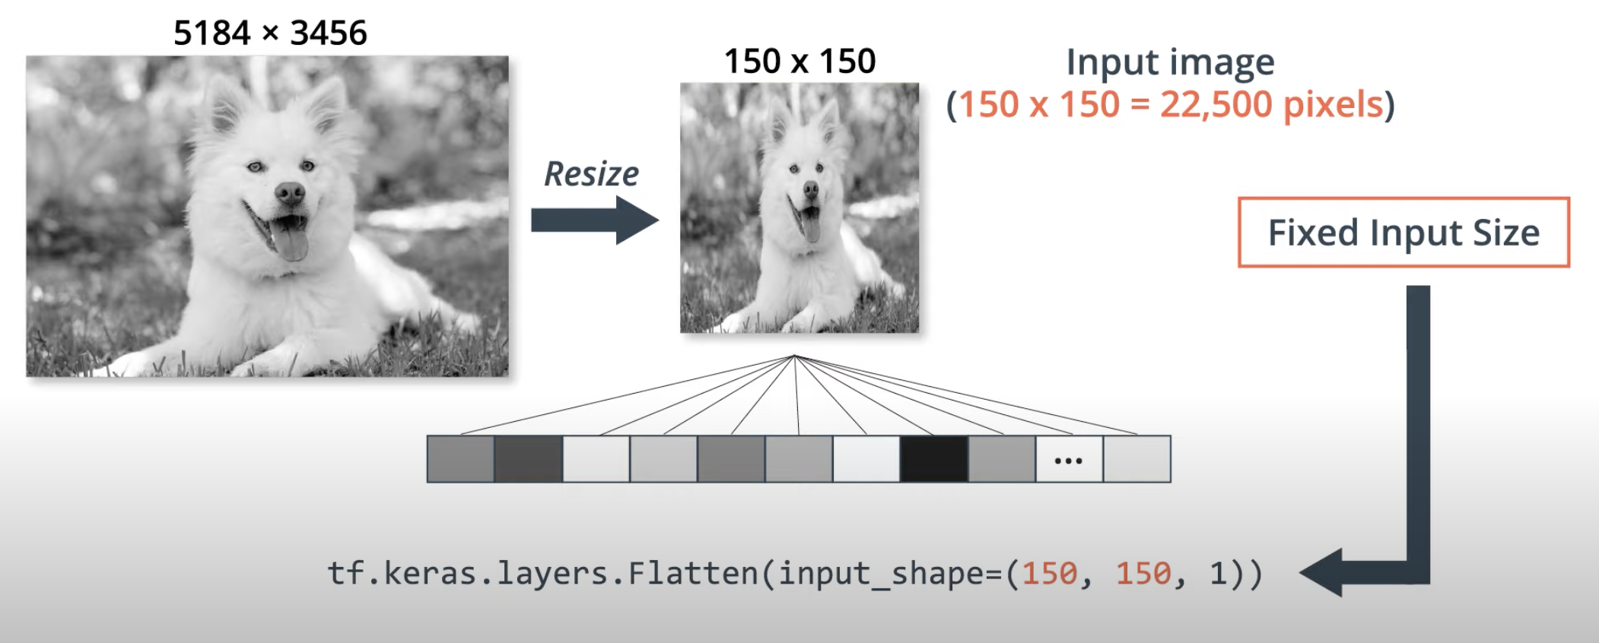
Cats and Dogs Dataset – Resizing Images

Slide 25
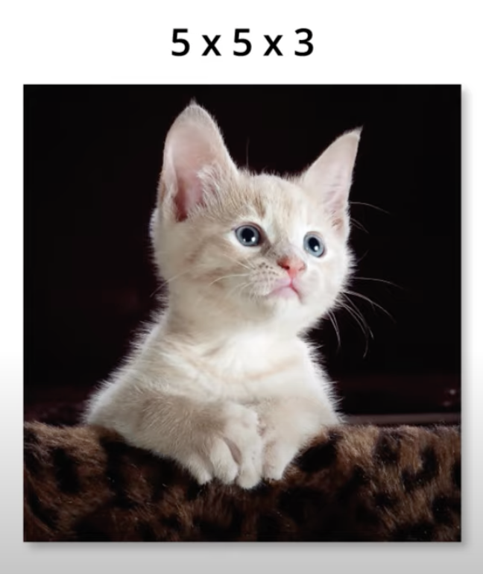
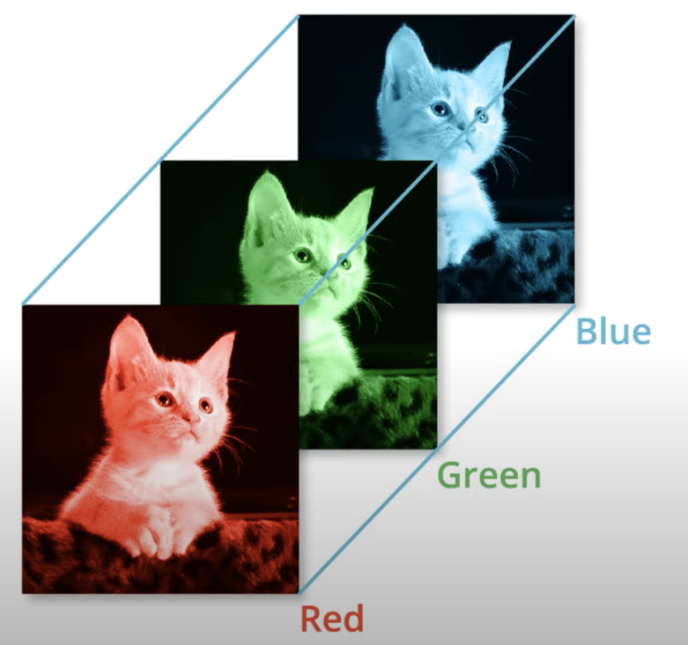

Cats and Dogs Dataset

Slide 26
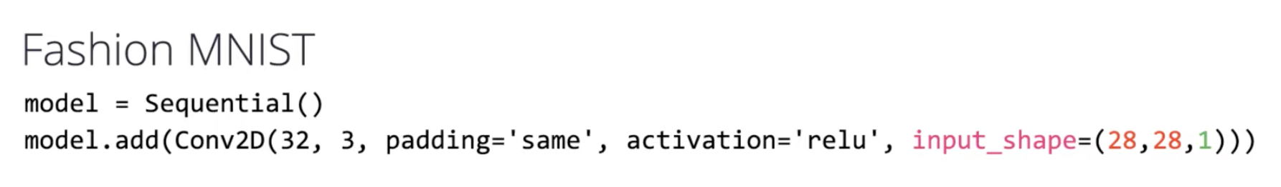
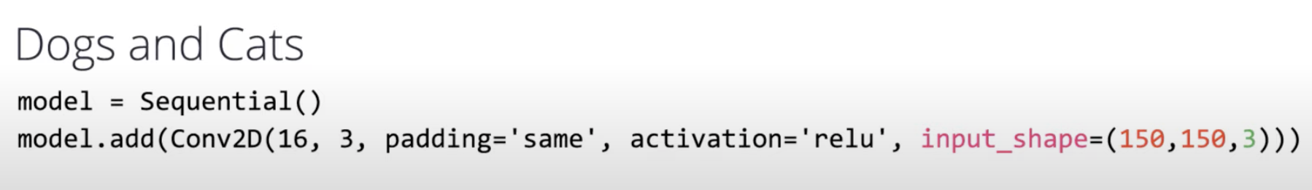
Cats and Dogs Dataset
Grey Scale Images
Colored Images
Resize Images

Slide 27
Convolutions with Color Images
https://towardsdatascience.com/a-comprehensive-guide-to-convolutional-neural-networks-the-eli5-way-3bd2b1164a53

Slide 28
CNN – Convolutional Neural Network
https://towardsdatascience.com/a-comprehensive-guide-to-convolutional-neural-networks-the-eli5-way-3bd2b1164a53

Slide 29
CNN – Convolutional Neural Network
Convolution Operation with Stride length 2
https://towardsdatascience.com/a-comprehensive-guide-to-convolutional-neural-networks-the-eli5-way-3bd2b1164a53

Slide 30

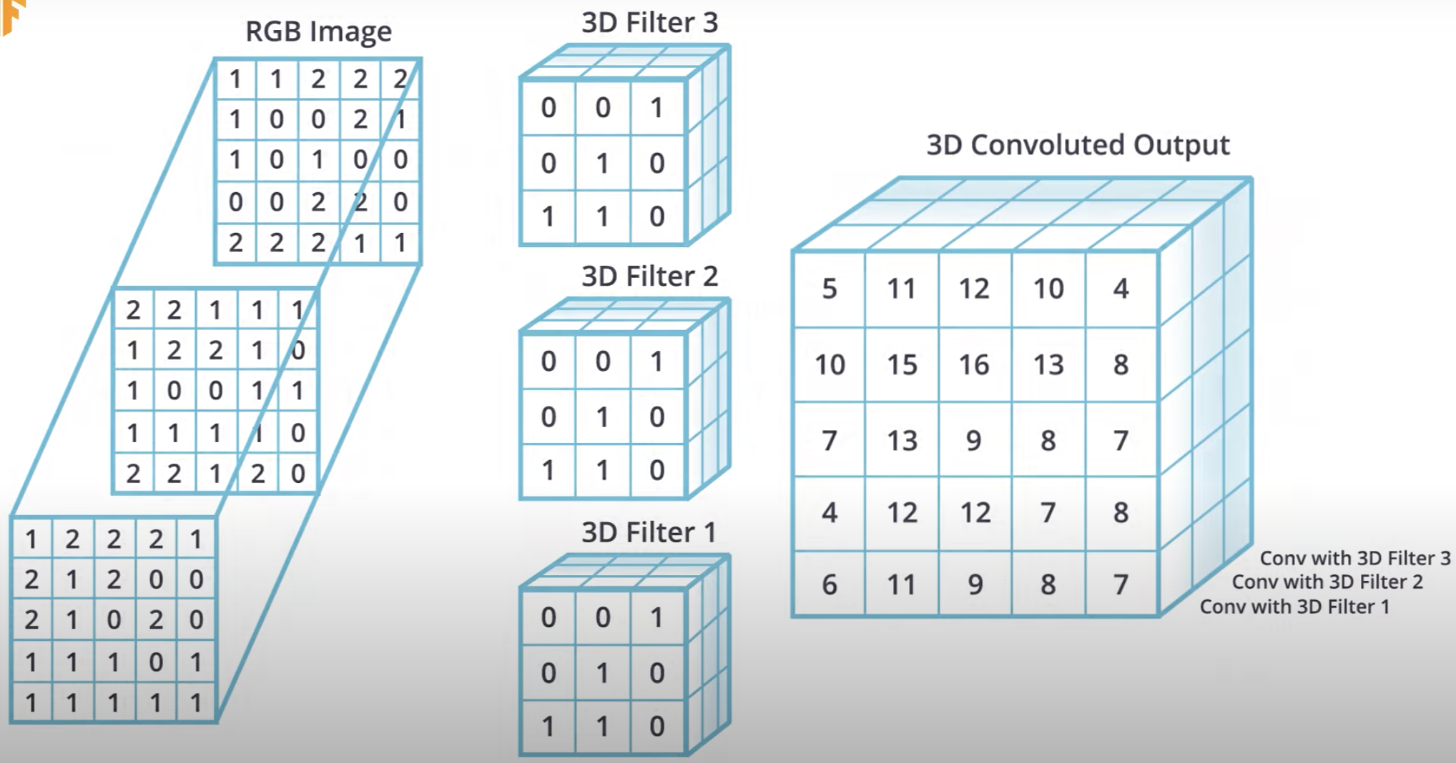

Slide 31
Pooling
Max Pooling
Average Pooling

Slide 32
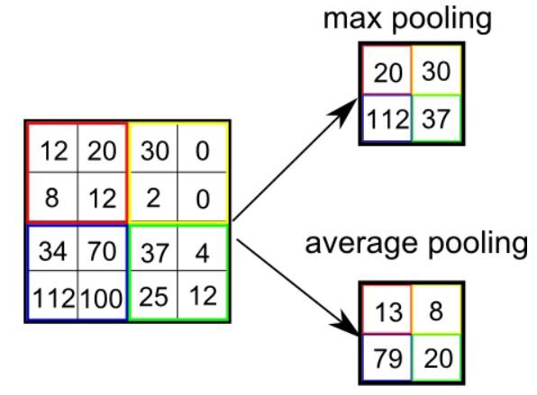
CNN – Convolutional Neural Network

Slide 33
Practical
https://github.com/DineshChopra/AI-ML/blob/master/TensorFlow/3_CNN_dogs_vs_cats_without_augmentation.ipynb

Slide 34
Summary
Intro of CNN Convolutional Neural Network
Practical
Image classification with Fashion MNIST Dataset by using CNN
Image classification with Cat vs Dogs Dataset by using CNN

Slide 35


Resources
Tutorial
https://www.tensorflow.org/tutorials/keras/classification
https://colab.research.google.com/github/tensorflow/docs/blob/master/site/en/tutorials/keras/classification.ipynb#scrollTo=9ODch-OFCaW4
https://www.udacity.com/course/intro-to-tensorflow-for-deep-learning--ud187
Free Course
How Neural Network Works ?
https://www.youtube.com/playlist?list=PLZHQObOWTQDNU6R1_67000Dx_ZCJB-3pi
MIT Introduction to Deep Learning | 6.S191
https://www.youtube.com/watch?v=njKP3FqW3Sk&list=PLtBw6njQRU-rwp5__7C0oIVt26ZgjG9NI

Slide 36


Slide 37
REVISION HISTORY
Rev No. | Date | Description of Change | Author | Review and Approved By
1.0 |  | Initial Draft | Dinesh Chopra | Tanmoy B (L&D)
2.0 |  |  | Dinesh Chopra

